Slide 1
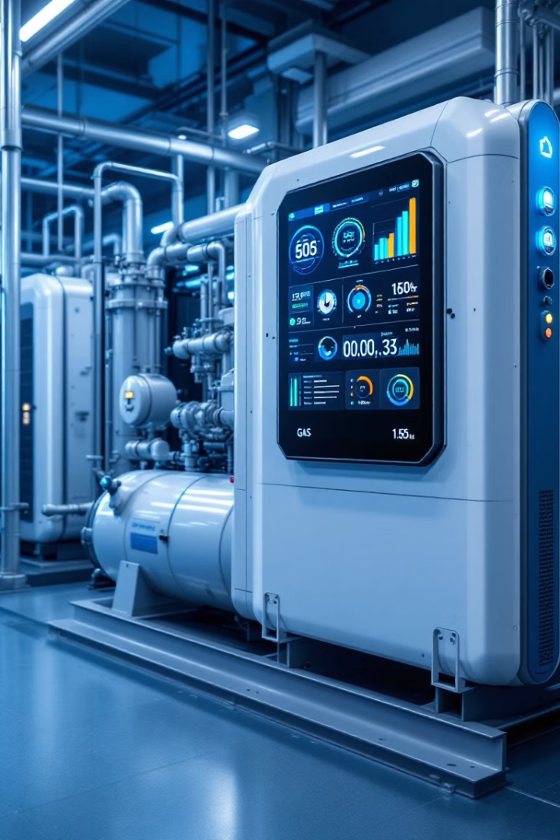

Maintelli: Predictive Maintenance for Gas Compressors
Deep learning approach to predict failures in Gas plant compressors
Team
Amal AlMukhlal, Hibah AlMashhad, Najla AlKhaldi

Slide 2
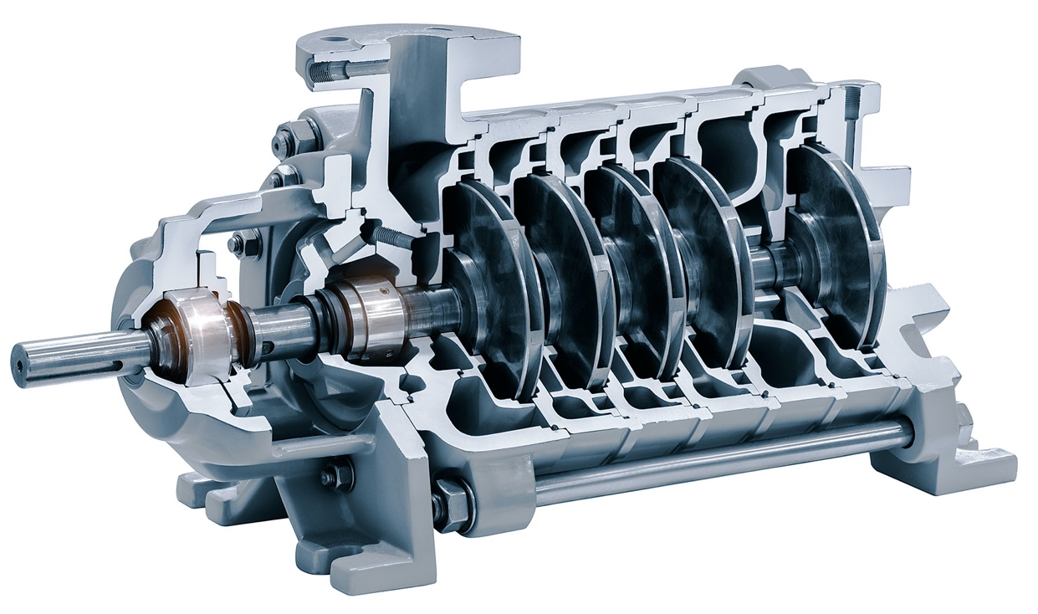


Project Overview
Goal
Detect failures before they happen. How? Minimize downtime, improve efficiency
Method
LSTM model to estimate remaining useful life

Slide 3



The Problem
Traditional Maintenance
Fixed intervals or manual checks
Unexpected Failures
Heavy losses from downtime
Unused Data
Valuable sensor data not utilized

Slide 4




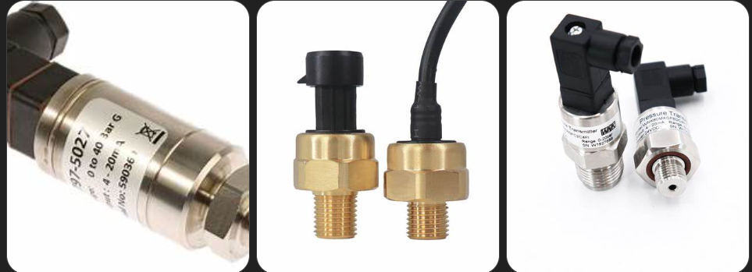

Our Approach
Data Simulation
Realistic sensor data for compressors
Preprocessing
Cleaning, normalization, window structuring
LSTM Model
Model normal behavior and detect anomalies
Evaluation
Accuracy, precision, recall, F1-score

Slide 5
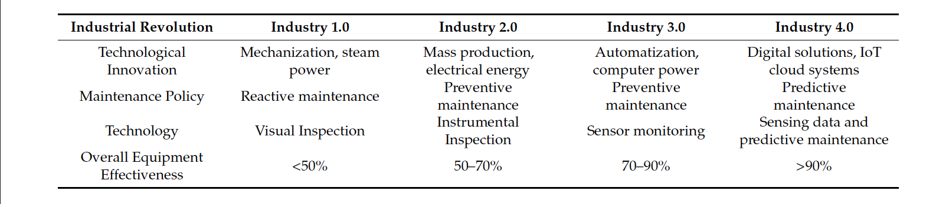
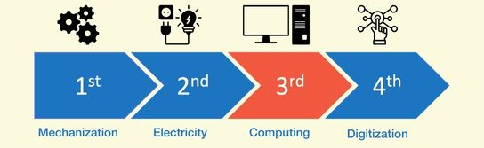
Reference: A. Achouch, A. El Hadi, and M. El Amri, “Predictive maintenance and fault monitoring enabled by machine learning: Experimental analysis of a TA-48 multistage centrifugal plant compressor,” Appl. Sci., vol. 13, no. 1790, pp. 1–21, 2023. [Online]. Available

Slide 6
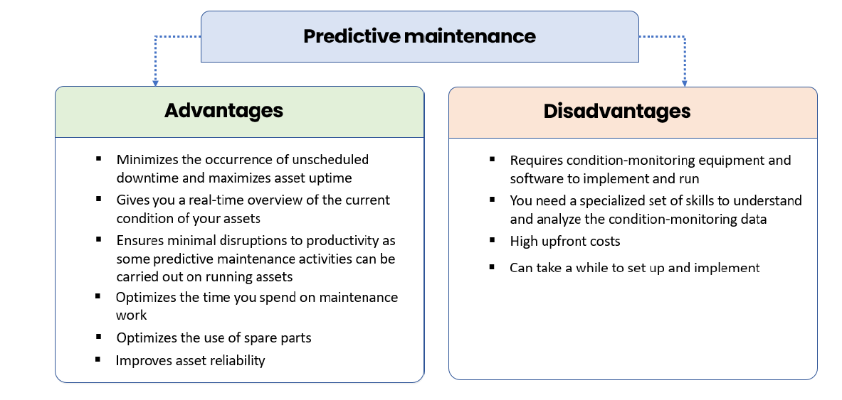
Reference: A. Achouch, A. El Hadi, and M. El Amri, “Predictive maintenance and fault monitoring enabled by machine learning: Experimental analysis of a TA-48 multistage centrifugal plant compressor,” Appl. Sci., vol. 13, no. 1790, pp. 1–21, 2023. [Online]. Available

Slide 7












Data Features
Pressure
Temperature
Suction and discharge (PSI)
Machine/environment (°C)
Motor Current
Vibration
Amperes
Level (mm/s)
Operational Hours
Flow Rate
Cumulative time
Cubic meters/hour
we are building unsupervised problem style, not multi-failure supervised classification, making the model sensitive
to various unseen failure patterns without requiring explicit failure labels.
Note:

Slide 8
Data Preprocessing
Interpolation: Handled missing values.
Feature Reduction: Dropped highly correlated features (> 95%).
Sequencing: Created input sequences from normal data only.
Scaling: Used Quantile Transformer for uniform scaling,
which is especially useful for LSTM models as it helps balance different sensor ranges
Notes:
"Before training the model, we performed several preprocessing steps to ensure the data was clean, reliable, and suitable for time-series analysis.
First, we handled missing values through linear interpolation, allowing smooth continuity across.
Then, we applied feature reduction by calculating the correlation matrix. Features with very high correlation — above 95% — were dropped to avoid redundancy.
Next, we created sequences from normal operational data only, because the model is trained in an unsupervised fashion — learning what 'healthy' behavior looks like.
Finally, we applied a Quantile Transformer to scale the features. This approach ensures each feature follows a uniform distribution, which is especially useful for LSTM models as it helps balance different sensor ranges."

Slide 9
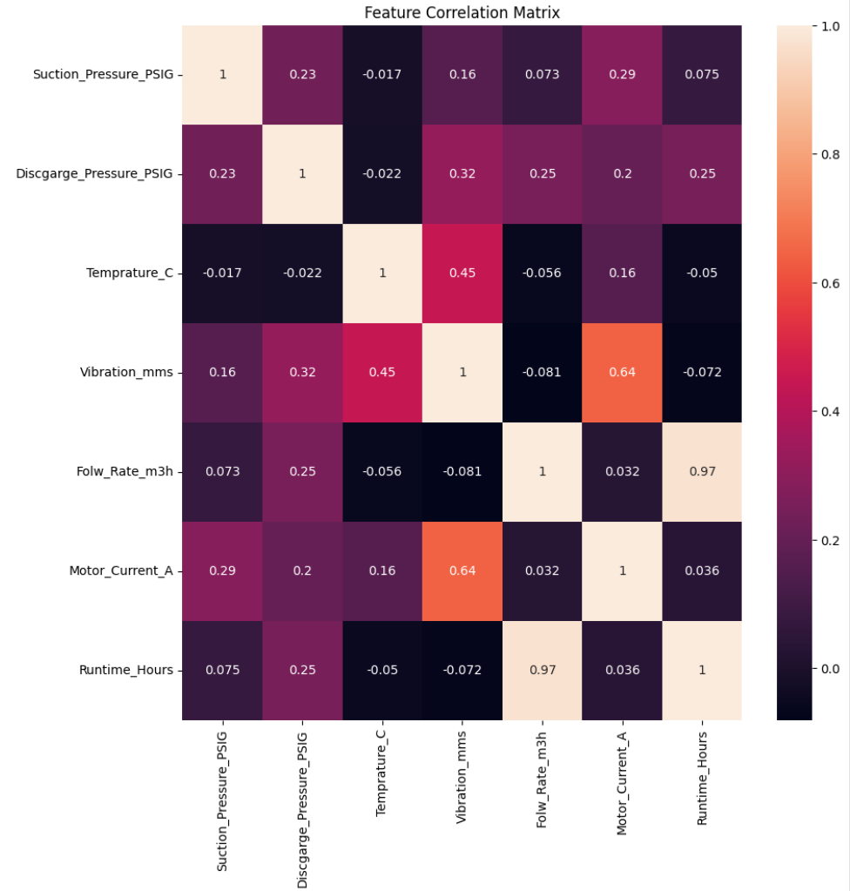
Feature Selection:
Correlation analysis is performed to identify and remove highly correlated features, preventing redundancy and potential issues caused by multicollinearity.
Notes:
For feature selection we used Feature correlation Matrix that shows how strongly each pair of features (sensor measurements) is related to each other by measuring the linear relationship btw two features.
In this correlation heatmap, Darker colors here indicate weaker correlation
While Lighter colors means higher correlation.
For example 'Flow Rate' and 'Runtime Hours' show a very strong positive correlation, meaning they were carrying almost the same information. so we can drop one of them to make the model simpler and faster.

Slide 10
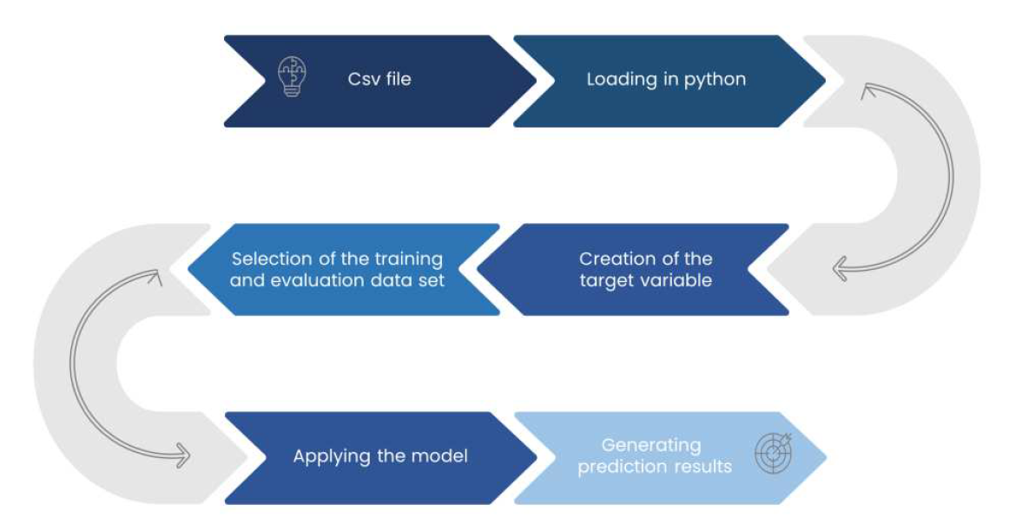
Description of Prediction Process
Reference: A. Achouch, A. El Hadi, and M. El Amri, “Predictive maintenance and fault monitoring enabled by machine learning: Experimental analysis of a TA-48 multistage centrifugal plant compressor,” Appl. Sci., vol. 13, no. 1790, pp. 1–21, 2023. [Online]. Available
Notes:
This step-by-step pipeline forms the foundation of predictive maintenance — using historical behavior to predict future failure.
It begins with loading the dataset in CSV format into Python. After that, we prepared the dataset for time-series modeling.
Next, we split our dataset into train and validate (taking in concederation the time order), since it is sequence-based prediction tasks. At the same time, I also generated the target variable, which in our case is the sensor readings at the next time step.
After preparing the data, I moved on to applying the trained LSTM model to the evaluation set. The model processes historical sequences of sensor data and outputs predicted future readings.
Finally, I evaluated the model by generating prediction results, comparing them to actual values using Mean Squared Error

Slide 11
LSTM Model Architecture

Slide 12
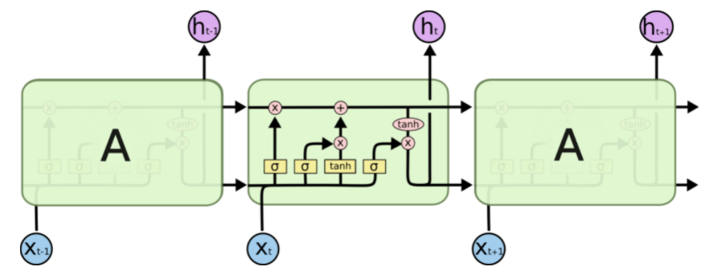
LSTM Model
LSTM Model Architecture
The ability to manage memory across long sequences is what makes LSTM particularly powerful for time-series prediction
Reference: Mayank, “LSTM, GRU, RNN | A Lazy Data Science Guide, MohitMayank.com. https://mohitmayank.com/a_lazy_data_science_guide/natural_language_processing/lstm_gru_rnn/ (accessed Apr. 28, 2025).
Notes:
"Here, I'm showing a conceptual overview of the LSTM model architecture.
LSTM stands for Long Short-Term Memory, and it is a special type of Recurrent Neural Network (RNN) designed specifically to handle sequential data and capture long-range dependencies.
In an LSTM, each block, shown here as 'A', is composed of several internal mechanisms called gates:
The forget gate decides what information to discard from the previous memory.
The input gate determines which new information should be added to the memory.
The output gate decides what the next hidden state should be based on the updated memory.
These gates work together to allow the network to selectively remember or forget information over long sequences, solving the vanishing gradient problem faced by standard RNNs.
This ability to manage memory across long sequences is what makes LSTM particularly powerful for time-series prediction

Slide 13
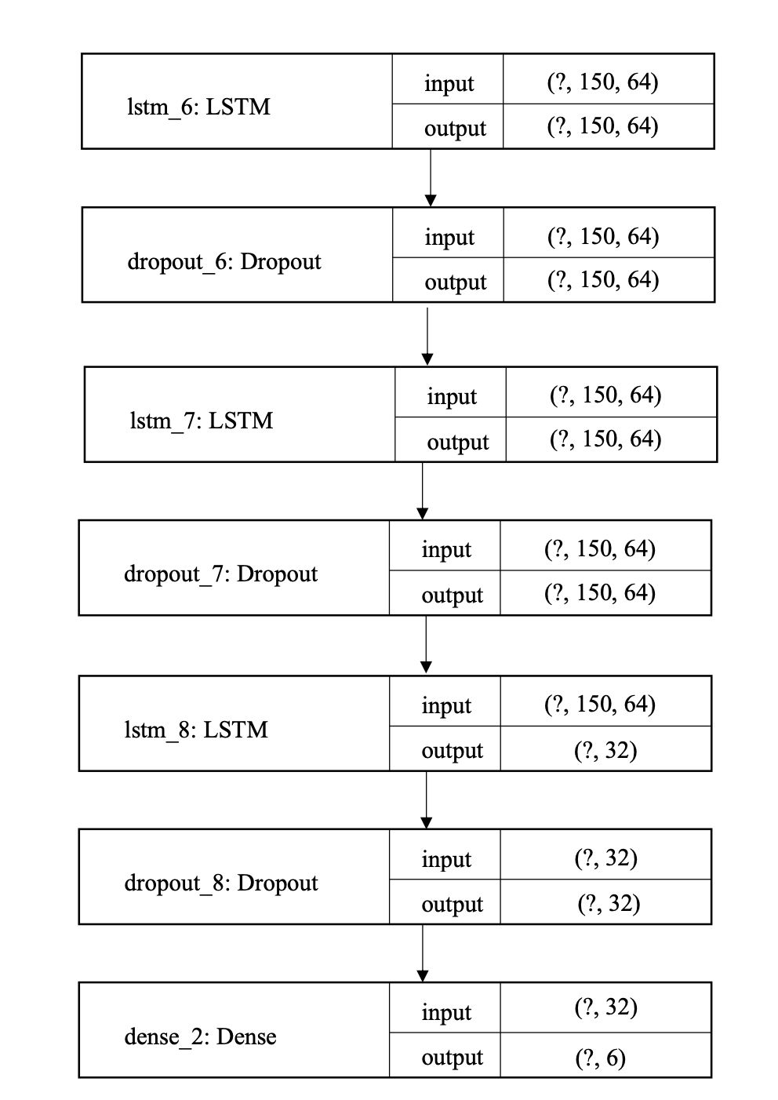
Model Architecture:
Three LSTM layers
Dropout layers (0.5) are added after each LSTM layer
Dense layer Predicts next time step values.
Notes:
"Now, let’s look at the architecture of the LSTM model we built for our project.
The model starts with a stack of three LSTM layers. The first two LSTM layers are set with return_sequences=True, which means they pass the entire sequence output to the next layer — allowing deep temporal feature learning. The final LSTM layer summarizes the sequence into a single vector by setting return_sequences=False.
After each LSTM, we’ve added a Dropout layer with a rate of 0.5. This helps to reduce overfitting by randomly deactivating half the neurons during training, encouraging the model to learn more.
Finally, a Dense layer maps the output to 7 values — one for each of the input features. This output represents the model’s prediction for the next time step’s sensor readings."
"The LSTM model includes three recurrent layers with 64, 64, and 32 units respectively. These units act as neurons with memory, capable of capturing both short- and long-term dependencies. The input sequence is 150 time steps long, and each LSTM layer transforms the temporal data into higher-level representations. The final Dense layer maps the 32-dimensional vector into 7 output values — corresponding to the expected sensor readings at the next time step. In total, the model has approximately 64,000 trainable parameters."

Slide 14
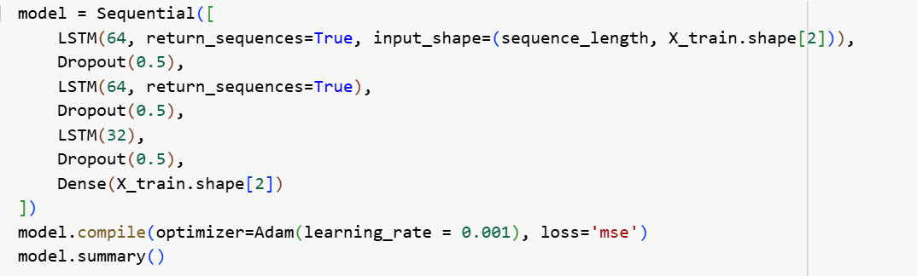
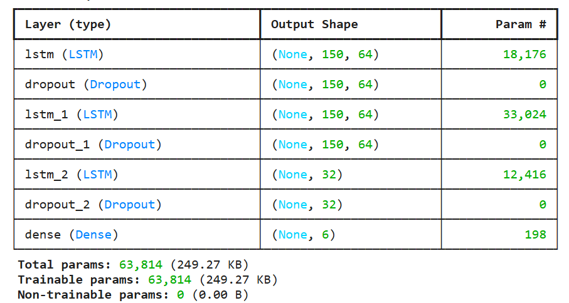
Training Strategy:

Slide 15
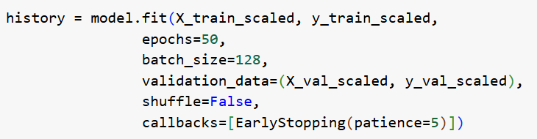
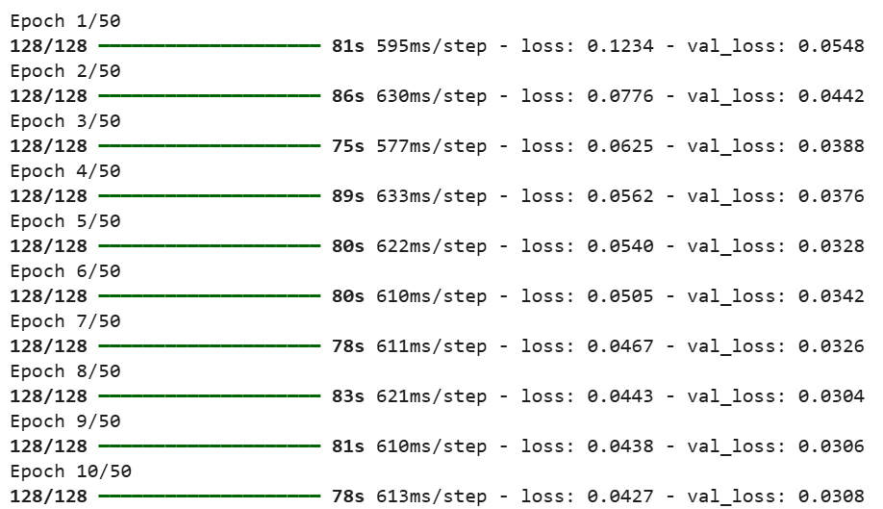
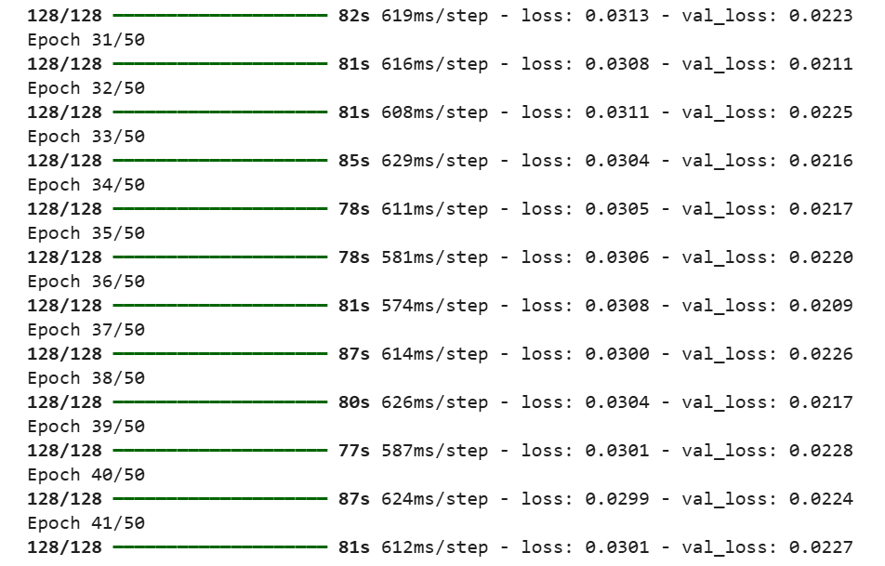
Training Analysis: (with early stop “Patience”
The final training loss is very low, and the validation loss remains stable, indicating that the model has learned well without overfitting
Notes:
Here we wanted to show the training behavior of LSTM model using early stopping. We trained the model for the max 50 epochs, but enabled early stopping with a patience of 5, means the training will stop if the val loss doesn’t improve for 5 epochs.
The final training loss is very low, and the validation loss remains stable, indicating that the model has learned well without overfitting."

Slide 16
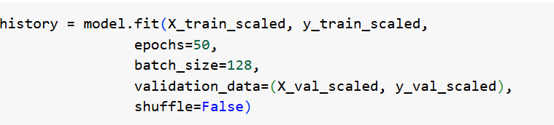
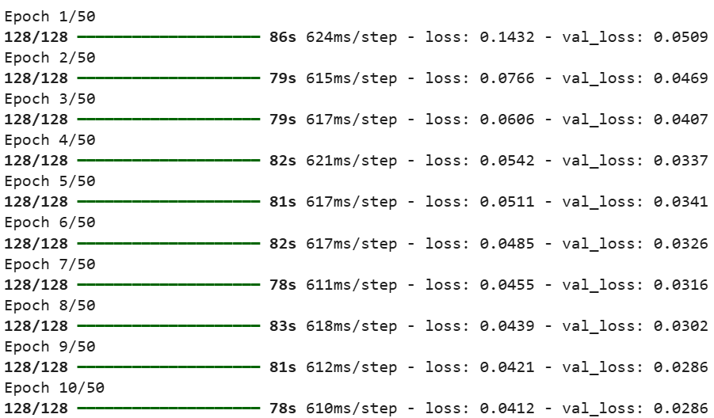
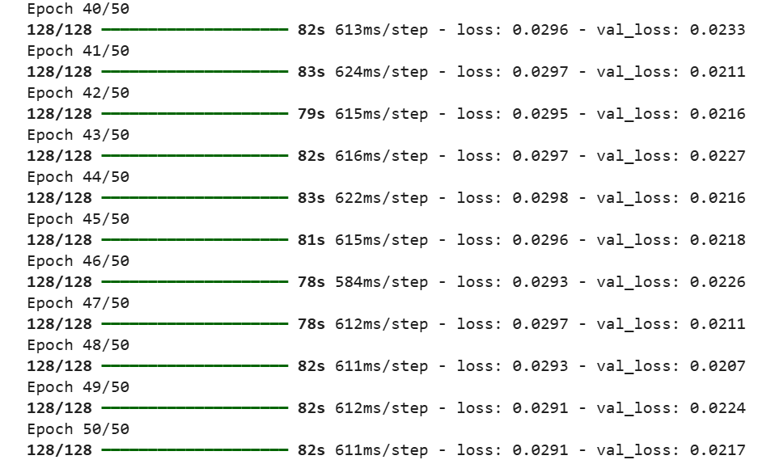
Training Analysis: (without early stop “Patience”)
Notes:
"Compared to the previous slide, this model trained for all 50 epochs, but the validation loss stopped improving early, so training longer didn’t help and may lead to overfitting."

Slide 17

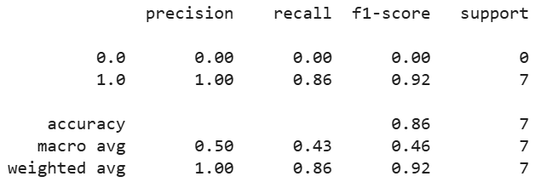
Model Performance
• Predicted behavior 2 hours before real breakdowns.
• Anomaly detection based on MSE Threshold (0.02).
• Metrics:
The accuracy is high overall, but more importantly, the model is able to catch most failures early — which is the main goal in predictive maintenance
Notes:
"This slide shows the performance of the final model. we tested the model by predicting behavior 2 hours before actual breakdowns, and used an MSE threshold of 0.02 to detect anomalies.
As you can see, the model successfully detected all 7 failure events, achieving a recall of 0.86 and an F1-score of 0.92 for the anomaly class. The accuracy is high overall, but more importantly, the model is able to catch most failures early — which is the main goal in predictive maintenance."

Slide 18
Results Visualization
Feature Correlation
Model Loss
MSE Visualization
Identifying relationships between sensors
Steady decrease over epochs
Failures exceeding 0.02 threshold

Slide 19
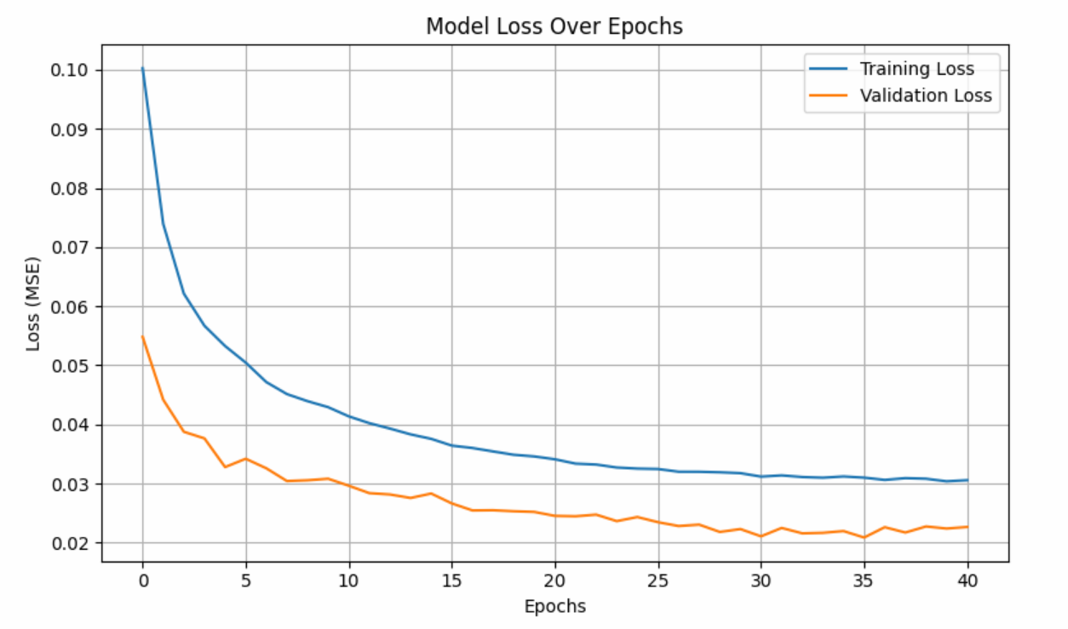
Results
Figure 3: model loss over epochs
Notes:
To visualize, "This graph shows the model's training and validation loss across epochs. We can see that both losses steadily decrease, with the validation loss stabilizing around epoch 35. This indicates that the model is learning effectively, and not overfitting

Slide 20
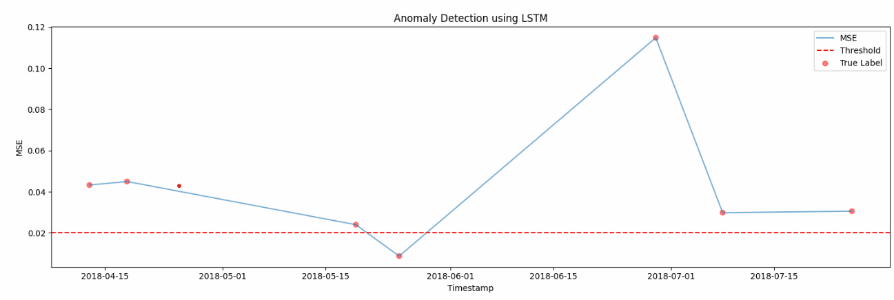
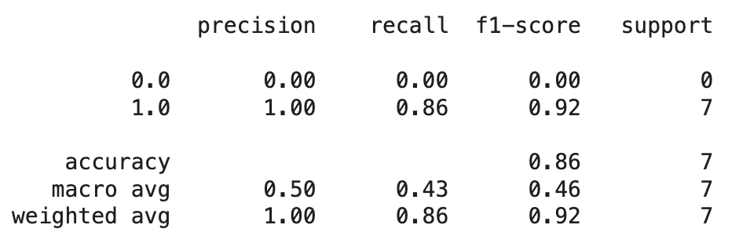
Results
Figure 4: classification report
Figure 6: MSE visualization
Observation
• LSTM Autoencoder predicts anomalies ahead of failures.
• Modeling only normal behavior is effective.
Notes:
To summaries,
The confusion matrix on the left shows that the model correctly identified most of the failure cases. The classification report confirms a strong recall of 0.86 and an F1-score of 0.92 for the anomaly class.
On the right, the MSE plot shows that the model’s error goes up just before failures, crossing the threshold and giving an early warning.
The key takeaway is that the LSTM autoencoder could predict failures even without seeing any failure data during training, proving that learning only normal behavior is effective for predictive maintenance."

Slide 21
Project Challenges & our Enhanced Model
 | Challenges | Enhancement
Dataset | Lack of real sensor data Limitation of features for the embedded dataset Limited number of records Records were generated randomly with leading to misclassification problem and persistent accuracy | Consult subject matter expert and acquire averages of real data to simulate accordingly Search for synthetic dataset with that simulates actual dataset characteristics Using techniques to increase the number of records to avoid imbalanced dataset / classification
Models | KNN, MLP, Decision Tree classifiers were used in old model | LSTM was selected
Accuracy | Above models and old dataset lead to persistent accuracy not changing although different techniques user, increase records through SMOTE, change the number of layers in MLP (MLP 63%, and very high un-logical accuracy in KNN, DT) | Using enhanced dataset simulating characteristics of real data Selecting LSTM model to train data which lead to enhanced accuracy

Slide 22

Future Work
Live Testing
Real-time Streaming
Deploy with real industrial compressor data
Implement in streaming environments
Federated Learning
Enhance data privacy frameworks

